Slide 1
Image Processing and Computer Vision
Introduction
Dr. Sk. Md. Masudul Ahsan
Professor, Dept of CSE, KUET

Slide 2

Analog Image
An image can be understood as a 2D light intensity function f(x,y) where:
x and y are spatial coordinates
The value of f at any point (x, y) is proportional to the brightness or gray value of the image at that point
Cannot be stored as such on a digital computer.

Slide 3
What is an image?
We can think of an image as a function, f, from R² to R:
f( x, y ) gives the intensity at position ( x, y )
Realistically, we expect the image only to be defined over a rectangle, with a finite range:
f: [a,b]x[c,d] → [0,1]
A color image is just three functions pasted together. We can write this as a “vector-valued” function:
Notes:
As opposed to [0..255]

Slide 4

Digital Image
A digitized image is one in which:
Spatial and grayscale values have been made discrete.
Intensities measured across a regularly spaced grid in x and y directions are sampled to
8 bits (256 values) per point for black and white,
3x8 bits per point for color images.
Stored as a 2D arrays of gray-level values. The array elements are called pixels and identified by their x, y coordinates.

Slide 5


What is a Digital Image?
A digital image is a representation of a two-dimensional image as a finite set of digital values, called picture elements or pixels
Images taken from Gonzalez & Woods, Digital Image Processing (2002)
Notes:
Real world is continuous – an image is simply a digital approximation of this.

Slide 6

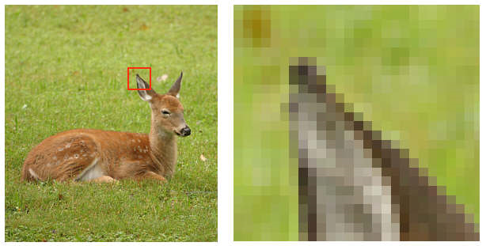
What is a Digital Image? (cont…)
Pixel values typically represent gray levels, colours, heights, opacities etc
Remember digitization implies that a digital image is an approximation of a real scene
Images taken from Gonzalez & Woods, Digital Image Processing (2002)
1 pixel

Slide 7
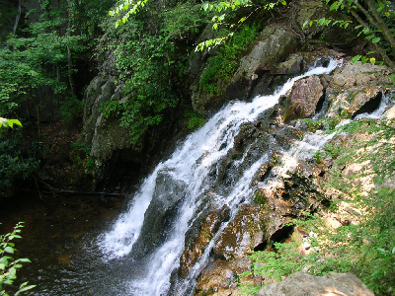

What is a Digital Image? (cont…)
Common image formats include:
1 sample per point (B&W or Grayscale)
3 samples per point (Red, Green, and Blue)
4 samples per point (Red, Green, Blue, and “Alpha”, a.k.a. Opacity)
For most of this course we will focus on grey-scale images

Slide 8
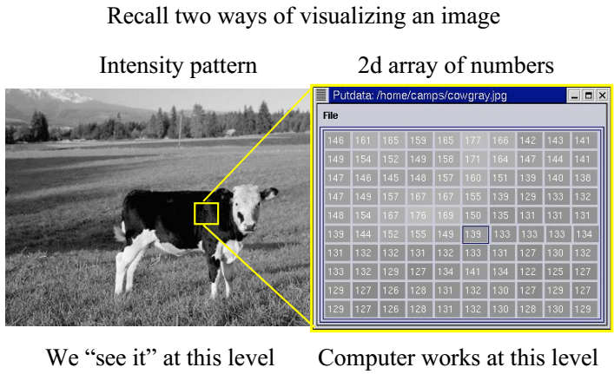
Visualizing Image

Slide 9
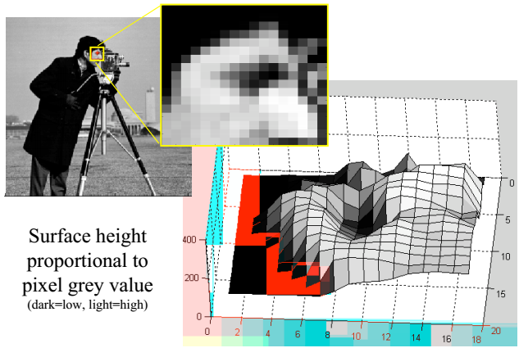
Images as Surfaces

Slide 10
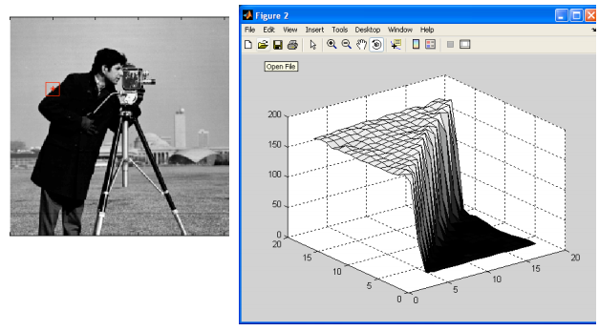
Images as Surfaces

Slide 11
What is Digital Image Processing?
Digital image processing focuses on two major tasks
Improvement of pictorial information for human interpretation
Processing of image data for storage, transmission and representation for autonomous machine perception
Some argument about where image processing ends and fields such as image analysis and computer vision start

Slide 12
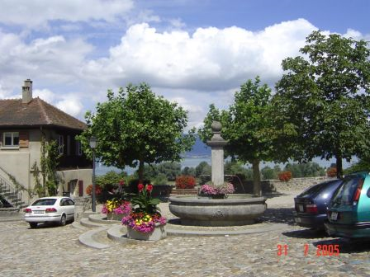
Computer Vision
Make computers understand images and video.
Computing properties of the 3D world from visual data (measurement)
Algorithms and representations to allow a machine to recognize objects, people, scenes, and activities. (perception and interpretation)
What kind of scene?
Where are the cars?
How far is the building?
…

Slide 13
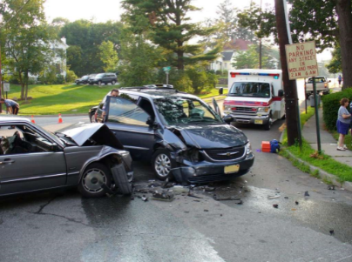
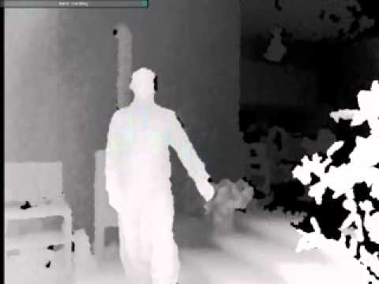
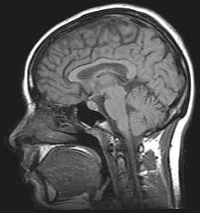
What is Computer Vision?
Computer vision is the science and technology of machines that see.
Concerned with the theory for building artificial systems that obtain information from images.
The image data can take many forms, such as a video sequence, depth images, views from multiple cameras, or multi-dimensional data from a medical scanner
Notes:
13

Slide 14
DIP to CV
The continuum from image processing to computer vision can be broken up into low-, mid- and high-level processes
Low Level Process
Mid Level Process
High Level Process
Input: Image Output: Image
Examples: Noise removal, image sharpening
Input: Image Output: Attributes
Examples: Object recognition, segmentation
Input: Attributes Output: Understanding
Examples: Scene understanding, autonomous navigation
In this course we will stop here
Notes:
Give the analogy of the character recognition system.
Low Level: Cleaning up the image of some text
Mid level: Segmenting the text from the background and recognising individual characters
High level: Understanding what the text says

Slide 15
Image Processing v.s. Computer Vision
Low Level
Image Processing
Acquisition, representation,
compression, transmission
image enhancement
edge/feature extraction
Pattern matching
image "understanding“
(Recognition, 3D)
Computer Vision
High Level

Slide 16
Why Computer Vision is Hard?
Inverse problems
Apriori-knowledge is required
Complexity extensive
Top-Down v.s. Bottom-Up paradigm
Parallelism
Non-local operations
Propagation of Information

Slide 17
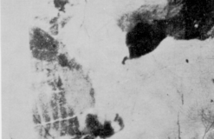

Slide 18
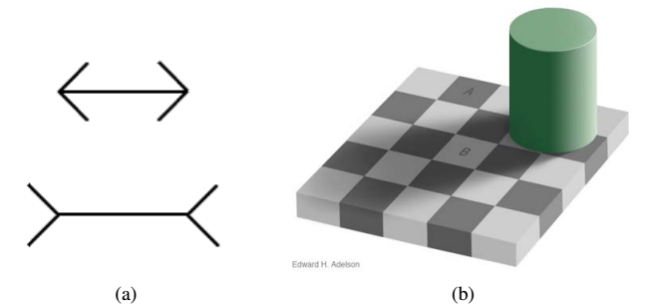
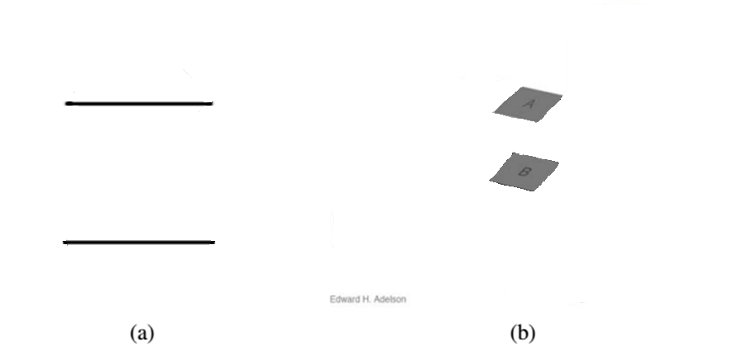
Vision is really hard

Slide 21
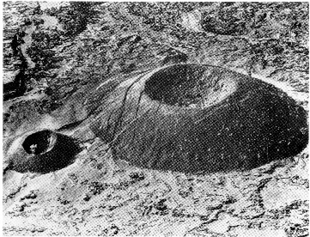
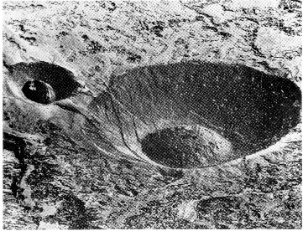

Slide 22
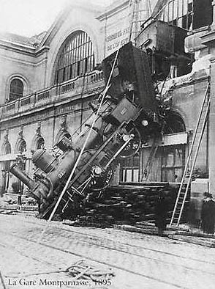
Every Picture Tells a Story
Black and white photo by H Roger-Viollet of a train accident at La Gare Montparnasse station in Paris on 22 October, 1895 when engine 120-721 failed to stop at the platform, went through a first-floor window and crashed down onto the street.
Goal of computer vision is to write computer programs that can interpret images.

Slide 23
Can computers match (or beat) human vision?
Yes and no (but mostly no!)
humans are much better at “hard” things
computers can be better at “easy” things
Notes:
If you can write a formula for it, computers can excel
Computer vision can’t solve the whole problem (yet), so breaks it down into pieces.
Many of the pieces have important applications.

Slide 24
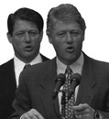
Human Perception Has Its Shortcomings…
Although this image appears to be a fairly run-of-the-mill picture of Bill Clinton and Al Gore, a closer inspection reveals that both men have been digitally given identical inner face features and their mutual configuration. Only the external features are different. It appears, therefore, that the human visual system makes strong use of the overall head shape in order to determine facial identity.
Sinha and Poggio, Nature, 1996
Notes:
Example where humans make mistakes that computers can avoid

Slide 25

Components of a computer vision system
Camera
Lighting
Computer
Scene
Scene Interpretation
Srinivasa Narasimhan’s slide

Slide 26
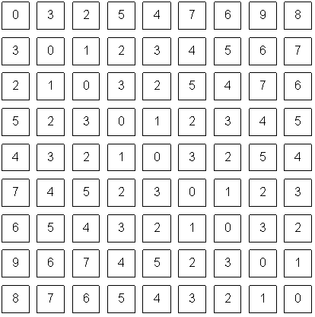
Computer vision vs human vision
What we see
What a computer sees

Slide 27
Related disciplines
Artificial intelligence
Machine learning
Graphics
Computer vision
Image processing
Cognitive science
Algorithms

Slide 28
Vision and graphics
graphics
vision
Inverse problems: analysis and synthesis.

Slide 29
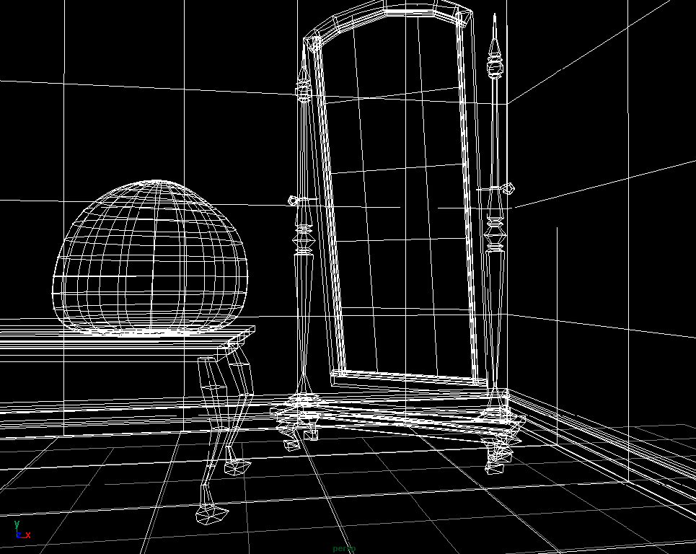
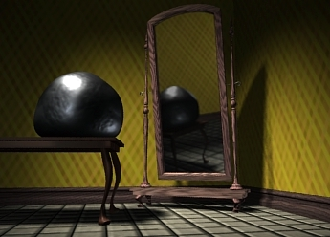
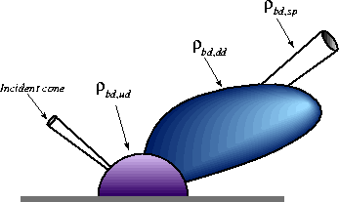
What is computer graphics? (3D->2D)
3D geometry
projection
Simulation
physics
GRAPHICS

Slide 30
What is computer vision? (2D->3D)
3D geometry
Estimation
physics

Slide 31
Why vision?
As image sources multiply, so do applications
Relieve humans of boring, easy tasks
Enhance human abilities: human-computer interaction, visualization
Perception for robotics / autonomous agents
Organize and give access to visual content

Slide 32

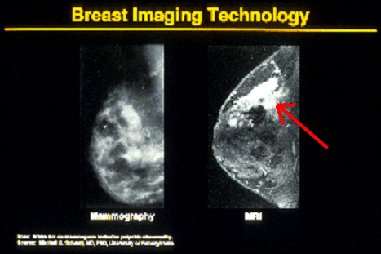

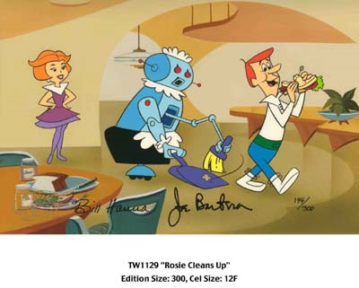
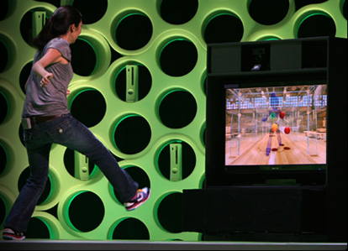
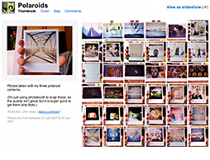
Why computer vision matters
Safety
Health
Security
Comfort
Fun
Access

Slide 33


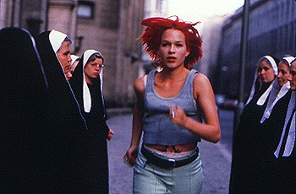
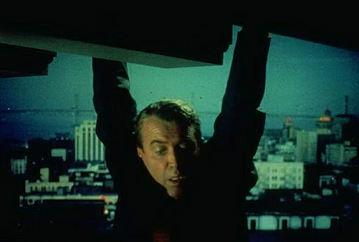
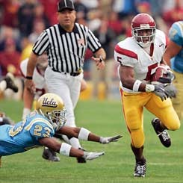


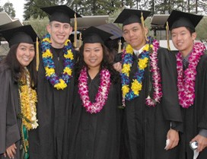
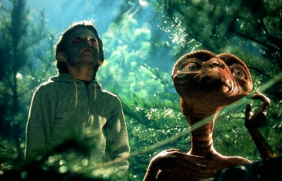


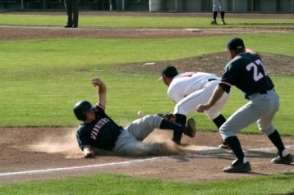






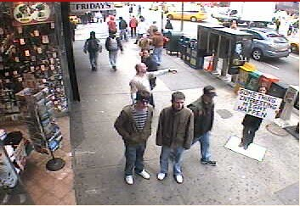
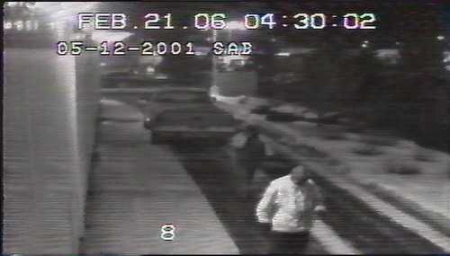
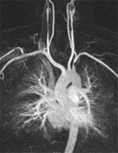
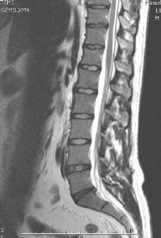
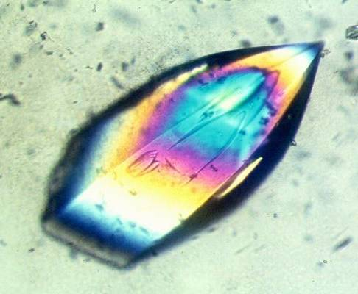
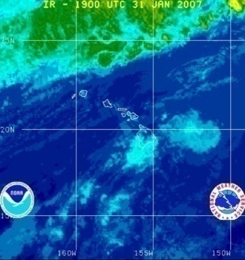
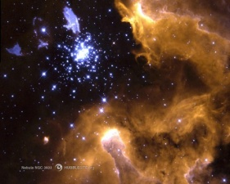
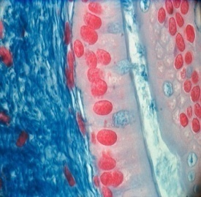
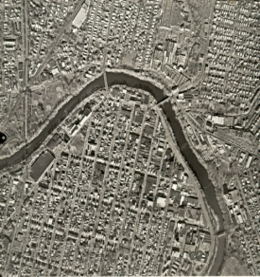
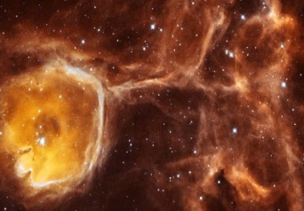
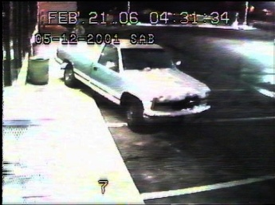
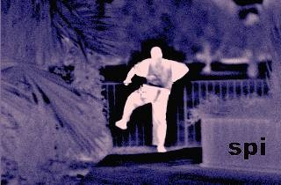
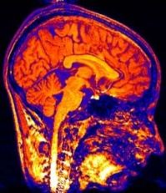
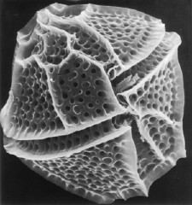
Why vision?
Images and video are everywhere!
Personal photo albums
Movies, news, sports
Surveillance and security
Medical and scientific images
Slide credit; L. Lazebnik

Slide 34
A little story about Computer Vision
In 1966, Marvin Minsky at MIT asked his undergraduate student Gerald Jay Sussman to “spend the summer linking a camera to a
computer and getting the computer to describe what it saw”. We now know that the problem is slightly more difficult than that. (Szeliski 2009, Computer Vision)

Slide 35
A little story about Computer Vision
Founder, MIT AI project
In 1966, Marvin Minsky at MIT asked his undergraduate student Gerald Jay Sussman to “spend the summer linking a camera to a
computer and getting the computer to describe what it saw”. We now know that the problem is slightly more difficult than that.

Slide 36
A little story about Computer Vision
In 1966, Marvin Minsky at MIT asked his undergraduate student Gerald Jay Sussman to “spend the summer linking a camera to a
computer and getting the computer to describe what it saw”. We now know that the problem is slightly more difficult than that.
Image Understanding

Slide 37
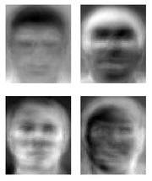
Ridiculously brief history of computer vision
1966: Minsky assigns computer vision as an undergrad summer project
1960’s: interpretation of synthetic worlds
1970’s: some progress on interpreting selected images
1980’s: ANNs come and go; shift toward geometry and increased mathematical rigor
1990’s: face recognition; statistical analysis in vogue
2000’s: broader recognition; large annotated datasets available; video processing starts; vision & graphis; vision for HCI; internet vision, etc.
Guzman ‘68
Ohta Kanade ‘78
Turk and Pentland ‘91

Slide 38
Current state of the art
The next slides show some examples of what current vision systems can do

Slide 39
Current state of the art
Optical character recognition (OCR): reading handwritten postal codes on letters (Figure 1.4a) and automatic number plate recognition (ANPR);
Machine inspection: rapid parts inspection for quality assurance using stereo vision with specialized illumination to measure tolerances on aircraft wings or auto body parts (Figure 1.4b) or looking for defects in steel castings using X-ray vision;
Retail: object recognition for automated checkout lanes (Figure 1.4c);
3D model building (photogrammetry): fully automated construction of 3D models from aerial photographs used in systems such as Bing Maps;
Notes:
Clips: terminator 2, enemy of the state (from UCSD “Fact or Fiction” DVD)

Slide 40
Current state of the art
Medical imaging: registering pre-operative and intra-operative imagery or performing long-term studies of people’s brain morphology as they age;
Automotive safety: detecting unexpected obstacles such as pedestrians on the street, under conditions where active vision techniques such as radar or lidar do not work well (Figure 1.4e; see also Miller, Campbell, Huttenlocher et al. (2008); Montemerlo, Becker, Bhat et al. (2008); Urmson, Anhalt, Bagnell et al. (2008) for examples of fully
automated driving);
Notes:
Clips: terminator 2, enemy of the state (from UCSD “Fact or Fiction” DVD)

Slide 41
Current state of the art
Match move: merging computer-generated imagery (CGI) with live action footage by tracking feature points in the source video to estimate the 3D camera motion and shape of the environment.
Such techniques are widely used in Hollywood (e.g., in movies such as Jurassic Park) (Roble 1999; Roble and Zafar 2009);
They also require the use of precise matting to insert new elements between foreground and background elements (Chuang, Agarwala, Curless et al. 2002).
Notes:
Clips: terminator 2, enemy of the state (from UCSD “Fact or Fiction” DVD)

Slide 42
Current state of the art
Motion capture (mocap): using retro-reflective markers viewed from multiple cameras or other vision-based techniques to capture actors for computer animation;
Surveillance: monitoring for intruders, analyzing highway traffic (Figure 1.4f), and monitoring pools for drowning victims;
Fingerprint recognition and biometrics: for automatic access authentication as well as forensic applications.
Notes:
Clips: terminator 2, enemy of the state (from UCSD “Fact or Fiction” DVD)

Slide 43
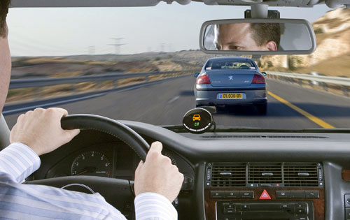
Industry and Applications
Automobile driver assistance
Lane departure warning
Adaptive cruise control
Obstacle warning
Digital Photography
Image Enhancement
Compression
Color manipulation
Image editing
Digital cameras
Sports analysis
sports refereeing and commentary
3D visualization and tracking sports actions
MobilEye system

Slide 44
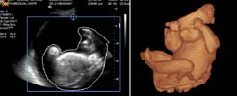
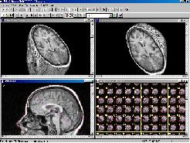
Film and Video
Editing
Special effects
Image Database
Content based image retrieval
visual search of products
Face recognition
Industrial Automation and Inspection
vision-guided robotics
Inspection systems
Medical and Biomedical
Surgical assistance
Sensor fusion
Vision based diagnosis
Astronomy
Astronomical Image Enhancement
Chemical/Spectral Analysis

Slide 45
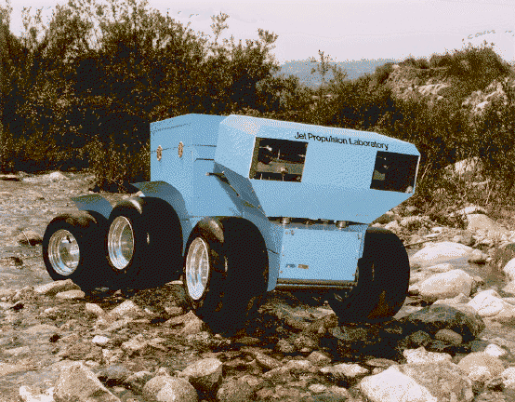
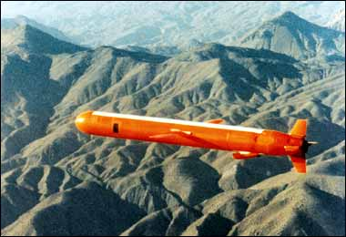
Arial Photography
Image Enhancement
Missile Guidance
Geological Mapping
Robotics
Autonomous Vehicles
Security and Safety
Biometry verification (face, iris)
Surveillance (fences, swimming pools)
Military
Tracking and localizing
Detection
Missile guidance
Traffic and Road Monitoring
Traffic monitoring
Adaptive traffic lights
Cruise Missiles

Slide 46


Image Denoising

Slide 47


Image Enhancement

Slide 48


Image Deblurring

Slide 49



Operations in Frequency Domain
Original Noisy image
Fourier Spectrum
Filtered image

Slide 50


Image Inpainting 1

Slide 51

Image Inpainting 2
Images of Venus taken by the Russian lander Ventra-10 in 1975

Slide 52


Image Inpainting 3

Slide 53


Video Inpainting
Y. Wexler, E. Shechtman and M. Irani 2004

Slide 54




Texture Synthesis

Slide 55

Prior Models of Images
3D prior of 2x2 image neighborhoods, From Mumford & Huang, 2000

Slide 56



Image Demosaicing

Slide 57


Optical character recognition (OCR)
Technology to convert scanned docs to text
If you have a scanner, it probably came with OCR software
Digit recognition, AT&T labs
http://www.research.att.com/~yann/
License plate readers
http://en.wikipedia.org/wiki/Automatic_number_plate_recognition

Slide 58

Face detection
Many new digital cameras now detect faces
Canon, Sony, Fuji, …
Notes:
Why would this be useful? Main reason is focus. Also enables “smart” cropping.

Slide 59
Smile detection?
Sony Cyber-shot® T70 Digital Still Camera

Slide 60

Object recognition (in supermarkets)
LaneHawk by EvolutionRobotics
“A smart camera is flush-mounted in the checkout lane, continuously watching for items. When an item is detected and recognized, the cashier verifies the quantity of items that were found under the basket, and continues to close the transaction. The item can remain under the basket, and with LaneHawk,you are assured to get paid for it… “

Slide 61

Earth Viewers (3D Modeling)
Image from Microsoft’s Virtual Earth
(see also: Google Earth)

Slide 62

Face recognition
Who is she?

Slide 63



Vision-based biometrics
“How the Afghan Girl was Identified by Her Iris Patterns” Read the story
Notes:
How the Afghan Girl was Identified by Her Iris Patterns
The remarkable story of Sharbat Gula, first photographed in 1984 aged 12 in a refugee camp in Pakistan by National Geographic photographer Steve McCurry, and traced 18 years later to a remote part of Afghanistan where she was again photographed by McCurry, is told by National Geographic in their magazine (April 2002 issue) and on their website.

Slide 64




Login without a password…
Fingerprint scanners on many new laptops, other devices
Face recognition systems now beginning to appear more widely http://www.sensiblevision.com/

Slide 65


Object recognition (in mobile phones)
This is becoming real:
Microsoft Research
Point & Find, Nokia

Slide 66


Special effects: shape capture
The Matrix movies, ESC Entertainment, XYZRGB, NRC

Slide 67

Sports
Sportvision first down line
Nice explanation on www.howstuffworks.com

Slide 68

Smart cars
Slide content courtesy of Amnon Shashua
Mobileye
Vision systems currently in high-end BMW, GM, Volvo models
By 2010: 70% of car manufacturers.
Video demo

Slide 69



Vision-based interaction (and games)
Digimask: put your face on a 3D avatar.
Nintendo Wii has camera-based IR tracking built in. See Lee’s work at CMU on clever tricks on using it to create a multi-touch display!
“Game turns moviegoers into Human Joysticks”, CNET
Camera tracking a crowd, based on this work.

Slide 70

Google cars
Oct 9, 2010. "Google Cars Drive Themselves, in Traffic". The New York Times. John Markoff
June 24, 2011. "Nevada state law paves the way for driverless cars". Financial Post. Christine Dobby
Aug 9, 2011, "Human error blamed after Google's driverless car sparks five-vehicle crash". The Star (Toronto)

Slide 71


Interactive Games: Kinect
Object Recognition: http://www.youtube.com/watch?feature=iv&v=fQ59dXOo63o
Mario: http://www.youtube.com/watch?v=8CTJL5lUjHg
3D: http://www.youtube.com/watch?v=7QrnwoO1-8A
Robot: http://www.youtube.com/watch?v=w8BmgtMKFbY

Slide 72

Vision in space
NASA'S Mars Exploration Rover Spirit captured this westward view from atop a low plateau where Spirit spent the closing months of 2007.
Vision systems (JPL) used for several tasks
Panorama stitching
3D terrain modeling
Obstacle detection, position tracking
For more, read “Computer Vision on Mars” by Matthies et al.

Slide 73


Robotics
NASA’s Mars Spirit Rover
http://en.wikipedia.org/wiki/Spirit_rover
http://www.robocup.org/

Slide 74


Medical imaging
3D imaging
MRI, CT
Image guided surgery
Grimson et al., MIT

Slide 75

Qualitative spatial information
slanted
non-rigid moving object
vertical
rigid moving object
rigid moving object
horizontal
slide credit: Fei-Fei, Fergus & Torralba

Slide 76



Challenges: viewpoint variation
Michelangelo 1475-1564
slide credit: Fei-Fei, Fergus & Torralba

Slide 77
Challenges: illumination
image credit: J. Koenderink

Slide 78

Challenges: scale
slide credit: Fei-Fei, Fergus & Torralba

Slide 79

Challenges: deformation
Xu, Beihong 1943
slide credit: Fei-Fei, Fergus & Torralba

Slide 80

Challenges: occlusion
Magritte, 1957
slide credit: Fei-Fei, Fergus & Torralba

Slide 81

Challenges: background clutter

Slide 82






Challenges: object intra-class variation
slide credit: Fei-Fei, Fergus & Torralba

Slide 83


Challenges: local ambiguity
slide credit: Fei-Fei, Fergus & Torralba

Slide 84
Challenges or opportunities?
Images are confusing, but they also reveal the structure of the world through numerous cues
Our job is to interpret the cues!
Image source: J. Koenderink

Slide 85

Bottom line
Perception is an inherently ambiguous problem
Many different 3D scenes could have given rise to a particular 2D picture
Possible solutions
Bring in more constraints ( or more images)
Use prior knowledge about the structure of the world
Need both exact measurements and statistical inference!
Image source: F. Durand

Slide 86
Current state of the art
You just saw examples of current systems.
Many of these are less than 5 years old
This is a very active research area, and rapidly changing
Many new apps in the next 5 years
To learn more about vision applications and companies
David Lowe maintains an excellent overview of vision companies
http://www.cs.ubc.ca/spider/lowe/vision.html

Slide 87


Textbook
“Digital Image Processing”,
Rafael C. Gonzalez & Richard E. Woods,
http://szeliski.org/Book/

Slide 88



Secondary Text

